Slide 1
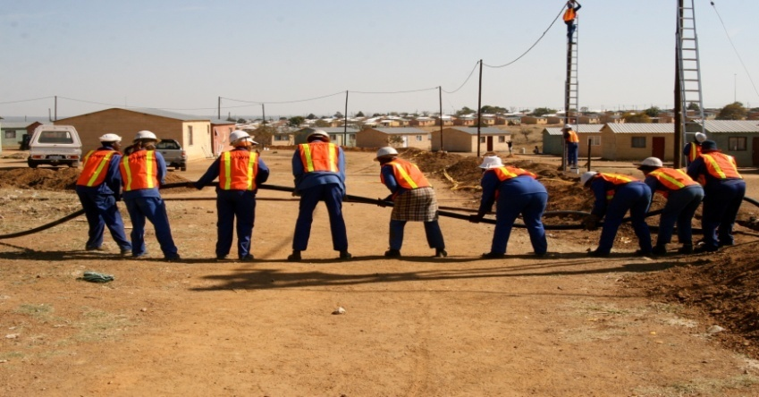
Expanded Public Works Programme 2018 Summit Commission 3: Expansion, Innovation and Partnerships

Slide 2
Commission 3: Expansion, Innovation and Partnerships
Issue | Action | Responsibility | Time Frames
1. Youth Unemployment – “a ticking time bomb”: How to create and design programmes that appeal to the youth? | FUNDING: Clear value propositions programmes for the youth Youth development projects to be provided with funds at a local level e.g. maintenance of public buildings Ring fence a portion of all infrastructure grants (MIG, WSIG) to implement LIC projects for maximising work opportunities TRAINING FOR EXIT: NYS-Community Service & Exit, training to be accredited and youth to exit the programme with credible qualifications | Implementing public bodies & Private sector | EPWP Phase 4
Notes:
What are sustainable livelihoods?
How does SL link with ED and training in EPWP?
Best practices for SL in EPWP?

Slide 3
Commission 3: Expansion, Innovation and Partnerships
Issue | Action | Responsibility | Time Frames
1. Youth Unemployment – “a ticking time bomb”: How to create and design programmes that appeal to the youth? | YOUTH INITIATED PROGRAMMES: Provide the youth with a platform for ideas to be utilised on various programmes and support Career path youth entry and exit at defined maximum age to ensure opportunities are availed to new participants. | Implementing public bodies, Private sector & Youth | EPWP Phase 4
Notes:
What are sustainable livelihoods?
How does SL link with ED and training in EPWP?
Best practices for SL in EPWP?

Slide 4
Commission 3: Expansion, Innovation and Partnerships
Issue | Action | Responsibility | Time Frames
1. Youth Unemployment – “a ticking time bomb”: How to create and design programmes that appeal to the youth? | YOUTH PROGRAMMES: EPWP to be flexible and consider non traditional programme to accommodate the needs of the youth e.g. 4th Industrial Revolution Expand EPWP across all sector public bodies e.g. Correctional services (Food security provision) Expand NYS programmes for youth across all EPWP Sectors. | Cont
Notes:
What are sustainable livelihoods?
How does SL link with ED and training in EPWP?
Best practices for SL in EPWP?

Slide 5
Commission 3: Expansion, Innovation and Partnerships
Issue | Action | Responsibility | Time Frames
1. Youth Unemployment – “a ticking time bomb”: How to create and design programmes that appeal to the youth? | Cont.. Target youth in a manner that considers their diversity(Youth are not a homogeneous group) Create a database in the private sector for the youth to identify entrepreneurial opportunities Encourage NYDA participation in all EPWP forums. | Cont.. | Cont.. Immediately
Notes:
What are sustainable livelihoods?
How does SL link with ED and training in EPWP?
Best practices for SL in EPWP?

Slide 6
Commission 3: Expansion, Innovation and Partnerships
Issue | Action | Responsibility | Time Frames
1. Youth Unemployment – “a ticking time bomb”: How to create and design programmes that appeal to the youth? | Use EPWP to mitigate unforeseen relevant challenges e.g. academic support staff to assist in mitigating poor school performance. | Implementing Bodies | EPWP Phase 4
Notes:
What are sustainable livelihoods?
How does SL link with ED and training in EPWP?
Best practices for SL in EPWP?

Slide 7
Commission 3: Expansion, Innovation and Partnerships
Issue | Action | Responsibility | Time Frames
1. Youth Unemployment – “a ticking time bomb”: How to create and design programmes that appeal to the youth? | INCLUSION: Establish formal partnerships with people with disabilities e.g. Community based peer support/parent support. Increase the participation of persons with disabilities at design stage | Cont..
Notes:
What are sustainable livelihoods?
How does SL link with ED and training in EPWP?
Best practices for SL in EPWP?

Slide 8
Commission 3: Expansion, Innovation and Partnerships
Issue | Action | Responsibility | Time Frames
2. Rural and Township economy: What programmes to be focused on rural and township economies, targeting Youth, women and people with disabilities | ENTERPRISE: SMME’s Development e.g. farming and training Social enterprises e.g. ECD PARTNERSHIPS: Explore potential relevant partners e.g. funding, technical support | Implementing bodies | EPWP Phase 4
Notes:
What are sustainable livelihoods?
How does SL link with ED and training in EPWP?
Best practices for SL in EPWP?

Slide 9
Commission 3: Expansion, Innovation and Partnerships
Issue | Action | Responsibility | Time Frames
3. Presidential Jobs Summit Framework Agreement: What should be done to increase the private sector support to the EPWP? | PARTNERSHIPS: Follow-up on agreed commitments such as: Identify clear mechanism to engage the private sector to support the programme Encourage private sector to put free Wifi in the rural areas and townships Road maintenance programmes Foster partnership with NYS programme within the private sector Private sector funding to be dedicated towards Non state Synergise government programme with the private sector i.e. Clean towns | Cont.. | Cont..
Notes:
What are sustainable livelihoods?
How does SL link with ED and training in EPWP?
Best practices for SL in EPWP?

Slide 10
I thank you

